Slide 1


AWS Direct Connect and VPNs

Slide 2
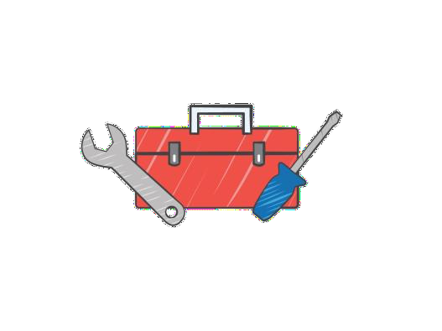







What to Expect from the Session

Slide 3

The Team
Network Engineering
Cloud Architects
Application Developers
AWS Solutions Architects & Support

Slide 4













Amazon VPC
Internet
Corporate Network
Virtual Private Cloud
R
Public Subnet
Private Subnet
VPN Only Subnet
NAT
Web Server Web Server
Availability Zone
Application Servers
Database Servers
Availability Zone
Availability Zone
Virtual Private Cloud
AWS Cloud

Slide 5







Amazon VPC

Slide 6

































Corporate Network
Internet ISP 1
Internet ISP 2 (BGP)
Internet ISP 3
Internet ISP 4
Internet ISP 5
FIREWALL
FIREWALL
OSPF
OSPF
.1
Backup GRE Tunnels
Router
Router
BGP
Inside GRE Tunnels Over IPSEC
Wireless Controller
Public IP
Router

Slide 7



Corporate Network

Slide 8
The Environment

Slide 9
The Environment

Slide 10



The Environment
CORP

Slide 11
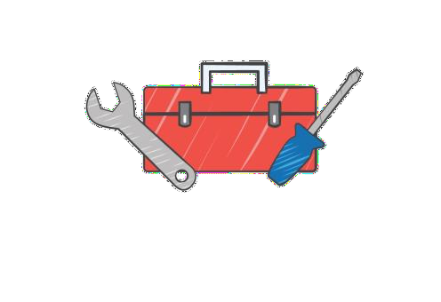


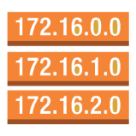




The Toolbox
Virtual Private Cloud
Route Tables Internet Gateway
Virtual Private Gateway
VPN Connection
Customer Gateway AWS Direct Connect

Slide 12
The Toolbox
VPC
VPN
Route Tables
CGW
IGW
DX
VGW

Slide 13
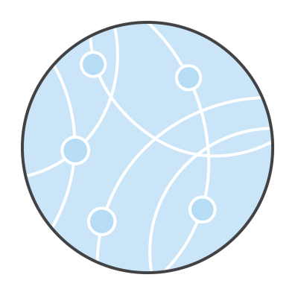
Connectivity Options
AWS Hardware VPN
AWS Direct Connect AWS VPN CloudHub Software VPN

Slide 14
AWS Hardware VPN

Slide 15
VPN Connection – IPsec
Internet Protocol Security (IPsec) is a protocol suite for securing Internet Protocol (IP) communications by authenticating and encrypting each IP packet of a communication session.
IPsec includes protocols for establishing mutual authentication between agents at the beginning of the session and negotiation of cryptographic keys to be used during the session.
Reference: Wikipedia - http://en.wikipedia.org/wiki/IPsec

Slide 16
VPN Connection – IPsec
Internet Protocol Security (IPsec) is a protocol suite for securing Internet Protocol (IP) communications by authenticating and encrypting each IP packet of a communication session.
IPsec includes protocols for establishing mutual authentication between agents at the beginning of the session and negotiation of cryptographic keys to be used during the session.
Reference: Wikipedia - http://en.wikipedia.org/wiki/IPsec

Slide 17
AWS VPN Features
Static or Dynamic (BGP)
Static requires routes (IP Prefixes) to be specified
Dynamic VPN supports max-prefixes of 100
BGP over VPN supports 2-byte AS Numbers

Slide 18
AWS VPN Requirements
Connections initiated from the Customer Gateway
IKE Security Association using a Pre-Shared Key
IPSec Security Associations in Tunnel Mode
AES 128-bit encryption, SHA-1 hashing function
Diffie-Hellman Perfect Forward Secrecy – Group 2
Dead Peer Detection
Fragment IP Packets before encryption

Slide 19





Static VPN
10.0.0.0 /16
10.0.0.0 /16
192.168.0.0 /16
192.168.0.0 /16
10.0.0.0 /16
1 unique Security Association (SA) pair per tunnel
1 inbound and 1 outbound
2 unique pairs for 2 tunnels – 4 SA’s
CORP

Slide 20




Static VPN
10.0.0.0 /16
0.0.0.0/0 (any)
172.16.0.0 /12 192.168.1.0 /24 192.168.9.0 /24
192.168.1.0 /24
192.168.9.0 /24
172.16.0.0 /12
0.0.0.0/0 (any)
•
•
Consolidate ACL’s to cover all IP’s Filter to block unwanted traffic
CORP

Slide 21
Static VPN
10.0.0.0 /16
10.0.0.0 /16
0.0.0.0 /0
(any)
0.0.0.0 /0
(any)
10.0.0.0 /16
•
•
Consolidate ACL’s to cover all IP’s Filter to block unwanted traffic
CORP

Slide 22

What is BGP ?
TCP based protocol on port 179
BGP Neighbors exchange routing information - prefixes
More specific prefixes are preferred
Uses Autonomous System Numbers – AS Numbers
iBGP – between peers in the same AS
eBGP – between peers in different AS
AS_PATH – measure of network “distance”
Local Preference – weighting of identical prefixes

Slide 23
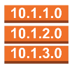



Dynamic VPN
10.0.0.0 /16
Tunnel 1
172.16.0.0 /16
IP 169.254.169.1 /30
BGP AS 7224
Tunnel 1
IP 169.254.169.2 /30
BGP AS 65001
Tunnel 2
IP 169.254.169.6 /30
Tunnel 2
BGP AS 65001
IP 169.254.169.5 /30
BGP AS 7224
Route Table
Destination | Target
10.0.0.0/16 | Local
172.16.0.0/16 | VGW
CORP

Slide 24
Dynamic VPN
10.0.0.0 /16
Tunnel 1
172.16.0.0 /16
IP 169.254.169.1 /30
BGP AS 17493
Tunnel 1
IP 169.254.169.2 /30
BGP AS 65001
Tunnel 2
IP 169.254.169.6 /30
Tunnel 2
BGP AS 65001
IP 169.254.169.5 /30
BGP AS 17493
BGP Peer IP Addresses are automatically generated
Customer AS Number – owned or private ASN
Amazon AS Number is fixed per region
CORP

Slide 25
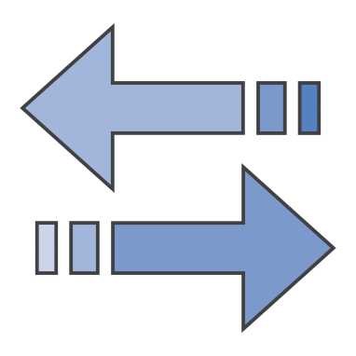
Path Selection – inside the VGW
Most specific IP prefix
192.168.10.0/24 over 192.168.0.0/16
Static VPN connections
Direct Connect (irrelevant of AS PATH length)
Shortest AS PATH
65001 i over 65001 65001 i

Slide 26


Resilient Dynamic VPN
iBGP OSPF
eBGP
CORP

Slide 27










Resilient Dynamic VPN – Multiple VPC’s
CORP

Slide 28
Re-usable Customer Gateway IP
Update to AWS VPN Solution
Rolling out across regions
Allows for the same Customer Gateway (CGW) IP
Create a new VGW and VPN then attach to your VPC
Note: Only one VGW can be attached to a VPC at one time.
Further features to be announced in the coming months

Slide 29
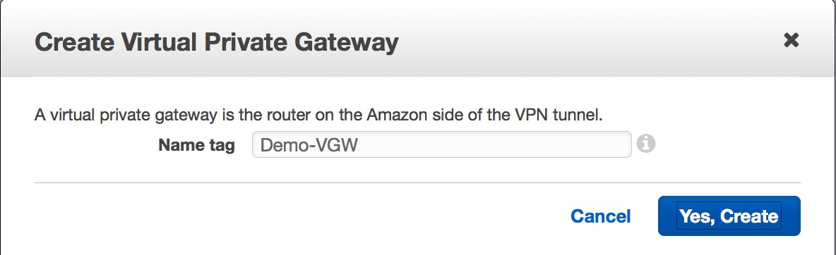
How to Create a VPN Connection
1. Create a VGW
Attach it to the VPC
Create a CGW
Create a VPN
Update Route Tables
6. Configure CGW

Slide 30
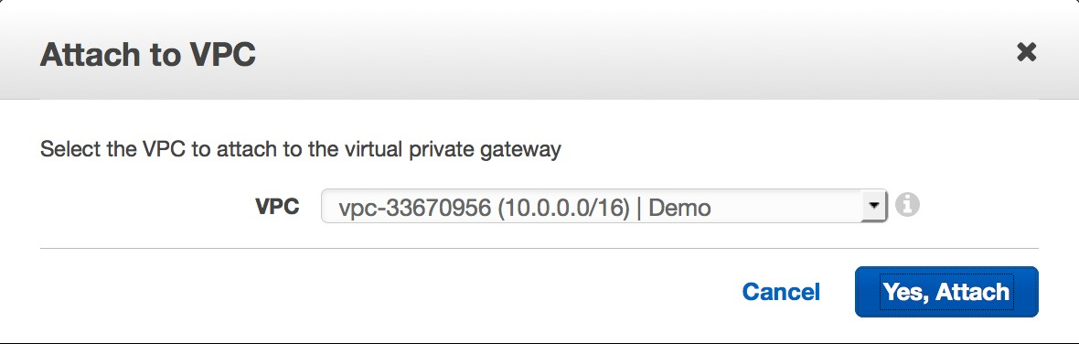
How to Create a VPN Connection
1. Create a VGW
2. Attach it to the VPC
Create a CGW
Create a VPN
Update Route Tables
6. Configure CGW

Slide 31
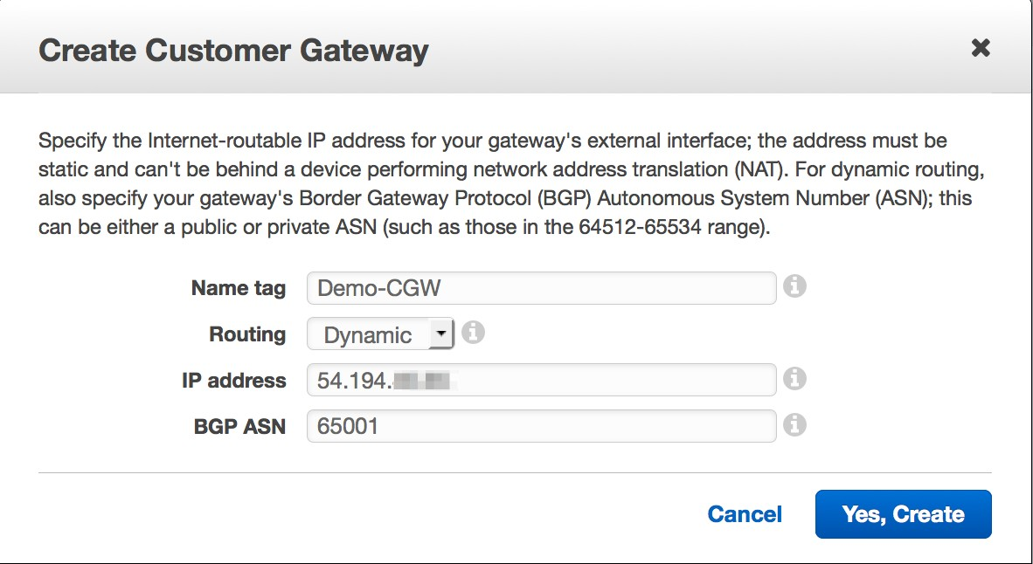
How to Create a VPN Connection
Create a VGW
Attach it to the VPC
3. Create a CGW
Create a VPN
Update Route Tables
6. Configure CGW

Slide 32
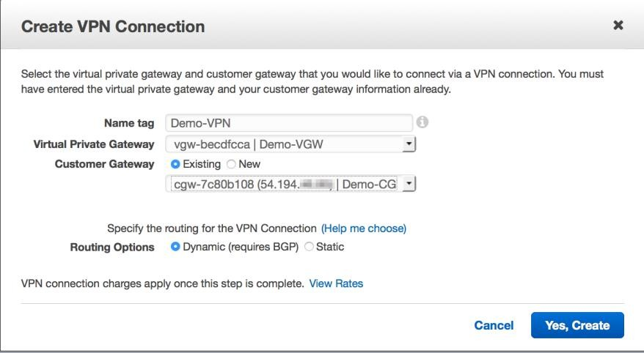
How to Create a VPN Connection
Create a VGW
Attach it to the VPC
Create a CGW
4. Create a VPN
5. Update Route Tables
6. Configure CGW

Slide 33
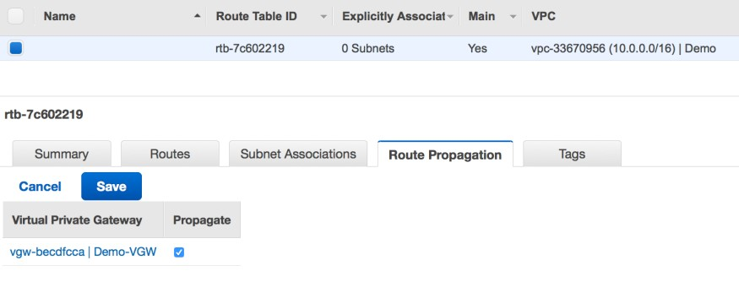
How to Create a VPN Connection
Create a VGW
Attach it to the VPC
Create a CGW
Create a VPN
5. Update Route Tables
6. Configure CGW

Slide 34
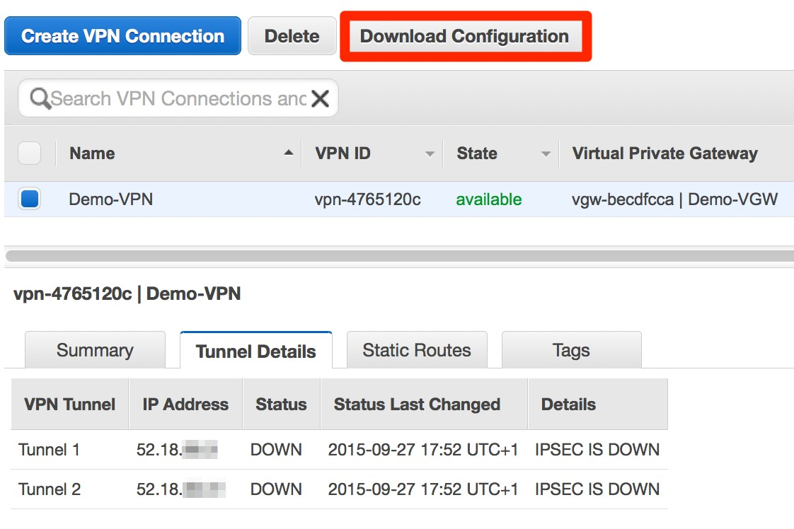
How to Create a VPN Connection
Create a VGW
Attach it to the VPC
Create a CGW
Create a VPN
Update Route Tables
6. Configure CGW

Slide 35

AWS Direct Connect

Slide 36


What is AWS Direct Connect…
Dedicated, private pipes into AWS
Create private (VPC) or public virtual interfaces to AWS
Reduced data-out rates (data-in still free)) Consistent network performance
At least 1 location to each AWS region
Option for redundant connections
Multiple AWS accounts can share a connection
Inter-Region enables connectivity to multiple regions in US Uses BGP to exchange routing information over a VLAN

Slide 37
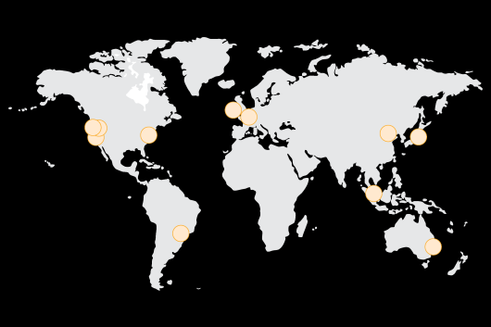
Direct Connect - Locations
AWS Region | AWS Direct Connect Location
Asia Pacific (Singapore) | Equinix SG2
Asia Pacific (Sydney) | Equinix SY3
Asia Pacific (Sydney) | Global Switch
Asia Pacific (Tokyo) | Equinix OS1
Asia Pacific (Tokyo) | Equinix TY2
China (Beijing) | Sinnet JiuXianqiao IDC
China (Beijing) | CIDS Jiachuang IDC
EU (Frankfurt) | Equinix FR5
EU (Frankfurt) | Interxion Frankfurt
EU (Ireland) | Eircom Clonshaugh
EU (Ireland) | TelecityGroup, London Docklands'
South America (Sao Paulo) | Terremark NAP do Brasil
US East (Virginia) | CoreSite NY1 & NY2
US East (Virginia) | Equinix DC1 - DC6 & DC10
US West (Northern California) | CoreSite One Wilshire & 900 North Alameda, CA
US West (Northern California) | Equinix SV1 & SV5
US West (Oregon) | Equinix SE2 & SE3
US West (Oregon) | Switch SUPERNAP, Las Vegas

Slide 38
Layers of Direct Connect
“Routing of traffic”
Layer 7 - Application
BGP
Layer 4 - Transport
TCP
Layer 3 - Network
Peer & Amazon IP
Layer 2 – Data Link
Ethernet – 802.1Q VLAN
Layer 1 - Physical
Single Mode Fiber – 1G or 10G

Slide 39
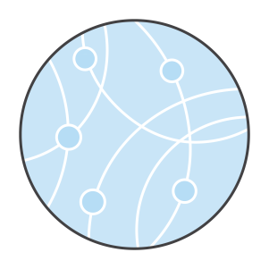
Terminology For Physical Connections
Leased Line Ethernet Private Line Pseudo-wire
Point-to-point circuit LAN Extension
MPLS / VPLS / IP-VPN / L3-VPN

Slide 40
Terminology For Physical Connections
}
Leased Line Ethernet Private Line Pseudo-wire
Point-to-point circuit LAN Extension
MPLS / VPLS / IP-VPN / L3-VPN
All generally deliver an “extension” of a port from a Direct Connect Location to a Customer Location

Slide 41
Terminology For Physical Connections
Leased Line Ethernet Private Line Pseudo-wire
Point-to-point circuit LAN Extension
MPLS / VPLS / IP-VPN / L3-VPN }
A little different …

Slide 42
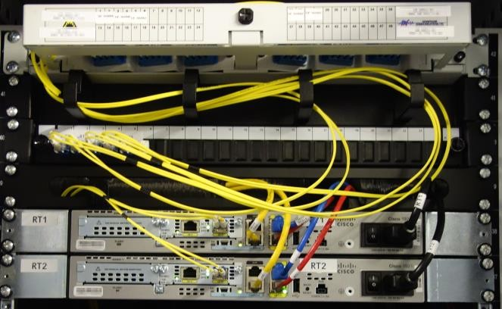
Physical Connection
Cross Connect at the location
Single Mode Fiber
- 1000Base-LX or 10GBASE-LR
Potential onward Delivery via Direct Connect Partner
Customer Router

Slide 43


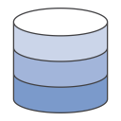
At the Direct Connect Location
Demarcation
AWS Backbone
Network
Cross
Connect
Customer Router
Access
Circuit
Customers Network
Backbone
Access
Circuit
DX Location
Colocation
Customer Network
AWS Direct Connect Routers
Customer Router
CORP

Slide 44

Dedicated Port via Direct Connect Partner
Demarcation
AWS Backbone
Network
Cross
Connect
Partner Equipment
Partner
Network
Access
Circuit
Customer Router
DX Location
Colocation
Partner Network
AWS Direct Connect Routers
CORP

Slide 45
At the Direct Connect Location – via MPLS
Demarcation
AWS Backbone
Network
Cross
Connect
Provider Edge
Partner MPLS
Core
Access
Circuit to CE
DX Location
Colocation
MPLS Core
CE Router
AWS Direct Connect Routers
Partner PE Router
CE Router
CORP

Slide 46
Layers of Direct Connect
A/C 1
Virtual Private Gateway
“Routing of traffic”
Virtual Interface (One per VLAN)
BGP
Peer & Amazon IP
Ethernet – 802.1Q VLAN
Direct Connect Connection
Single Mode Fiber – 1G or 10G

Slide 47
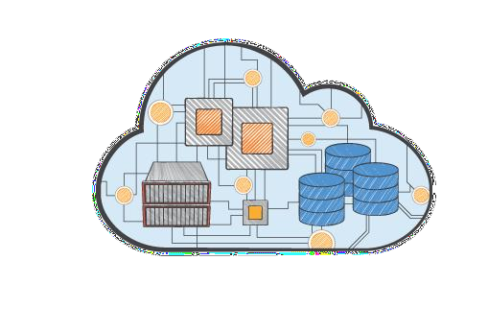
Public and Private Virtual Interfaces
802.1Q VLAN
eBGP Session
Note: Max Prefixes on the AWS peer : 100
Private Virtual Interface – Access to VPC
Note: Not VPC Endpoints or transitive via VPC Peering
Public Virtual Interface – Access to non-VPC Services

Slide 48
Account ownership of Direct Connect
A/C 2
Virtual Private Gateway
“Routing of traffic”
Hosted Virtual Interface (One per VLAN)
BGP
Peer & Amazon IP
Ethernet – 802.1Q VLAN
A/C 1
Direct Connect Connection
Single Mode Fiber – 1G or 10G

Slide 49
Sub-1G via Direct Connect Partner
50Mbps, 100Mbps, 200Mbps, 300Mbps, 400Mbps and 500Mbps
Virtual Private Gateway
“Routing of traffic”
Customer
Virtual Interface
(Single)
BGP
Peer & Amazon IP’s
Hosted Connection
Bandwidth
VLAN
Ethernet – 802.1Q VLAN
Partner
Direct Connect Interconnect
Single Mode Fiber – 1G or 10G

Slide 50
Sharing Hosted Connections
Customer A/C 2
Virtual Private Gateway
“Routing of traffic”
Hosted Virtual Interface
(Single)
BGP
Peer & Amazon IP’s
A/C 1
Hosted Connection
Bandwidth
VLAN
Ethernet – 802.1Q VLAN
Partner
Direct Connect Interconnect
Single Mode Fiber – 1G or 10G

Slide 51
Private Virtual Interface
Only provides access to resources in a VPC
Note: Not VPC Endpoints or transitive via VPC Peering
Attaches to the Virtual Private Gateway
Same as a VPN Connection
Multiple Private VIF’s can be attached for resilience
Any IP Addresses and ASN for BGP Peering acceptable

Slide 52



Single Private Virtual Interface
dxvif-wwxxyyzz
VLAN 100
IP 169.254.254.9 /30
BGP AS 7224
MD5 Key
Interface gi0/0.100
VLAN 100
IP 169.254.254.10 /30
BGP AS 65001
MD5 Key
10.0.0.0 /16
172.16.0.0 /16
AS7224 Announcing
10.0.0.0 /16
eBGP
AS65001 Announcing
172.16.0.0 /16
Route Table
Destination | Target | Propagated
10.0.0.0/16 | Local
172.16.0.0/16 | VGW | Yes
CORP

Slide 53


Dual DX – Single Location
DX Location
Colocation
Service Provider Network
Customer Router
AWS Direct Connect Routers
CORP

Slide 54
Dual Private Virtual Interface
dxvif-wwxxyyzz
Interface gi0/0.100
VLAN 100
IP 169.254.254.10 /30
BGP AS 65001
MD5 Key
10.0.0.0 /16
VLAN 100
172.16.0.0 /16
IP 169.254.254.9 /30
BGP AS 7224
eBGP
MD5 Key
dxvif-aabbccdd
VLAN 100
IP 169.254.254.13 /30
BGP AS 7224
MD5 Key
Interface gi0/0.100
VLAN 100
IP 169.254.254.14 /30
BGP AS 65001
MD5 Key
eBGP
CORP

Slide 55
Dual Private Virtual Interface
dxvif-wwxxyyzz
Interface gi0/0.100
10.0.0.0 /16
VLAN 100
VLAN 100
172.16.0.0 /16
IP 169.254.254.9 /30
IP 169.254.254.10 /30
BGP AS 7224
eBGP
BGP AS 65001
MD5 Key
MD5 Key
dxvif-aabbccdd
Interface gi0/0.100
VLAN 100
VLAN 100
IP 169.254.254.13 /30
IP 169.254.254.14 /30
BGP AS 7224
eBGP
BGP AS 65001
MD5 Key
MD5 Key
CORP

Slide 56
Dual DX – Single Location revisited
DX Location
Colocation
Service Provider Network
Customer Router
AWS Direct Connect Routers
CORP

Slide 57

Dual DX – Single Location revisited
DX Location
Colocation
Service Provider Network
AWS Direct Connect Routers
Customer Routers
CORP

Slide 58





Single DX – Dual Location
DX Location 1
Colocation
AWS Direct Connect Routers
Customer
Routers
Service Provider Network
DX Location 2
Colocation
AWS Direct Connect Routers
Customer
Routers
CORP

Slide 59




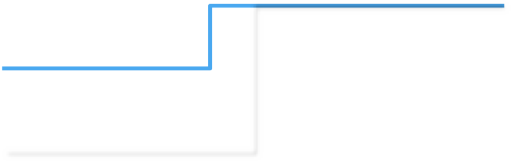
Dual DX – Dual Location
DX Location 1
Colocation
AWS Direct Connect Routers
Customer
Routers
Service Provider Network
DX Location 2
Colocation
AWS Direct Connect Routers
Customer
Routers
CORP

Slide 60

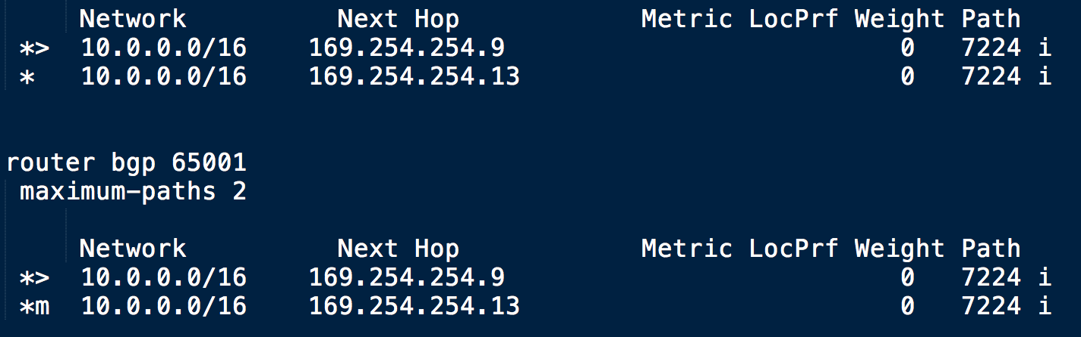
Dual VIF – Active/Active
IP 169.254.254.9 /30
IP 169.254.254.13 /30

Slide 61


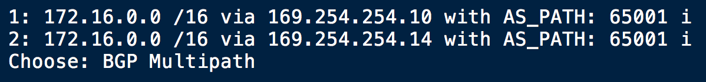
Active/Active – the VGW Perspective
IP 169.254.254.10 /30
IP 169.254.254.14 /30

Slide 62
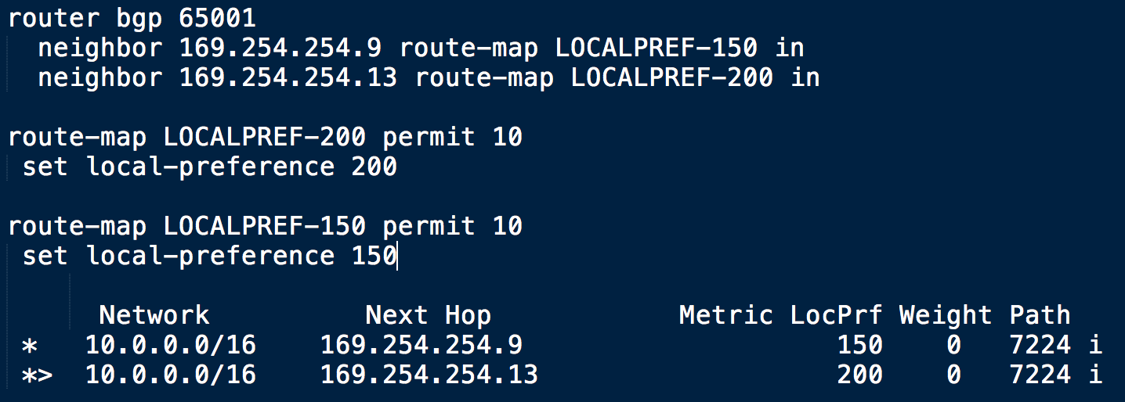
Dual VIF – Active/Passive
IP 169.254.254.9 /30
IP 169.254.254.13 /30

Slide 63
Active/Passive – the VGW Perspective
IP 169.254.254.10 /30
IP 169.254.254.14 /30

Slide 64
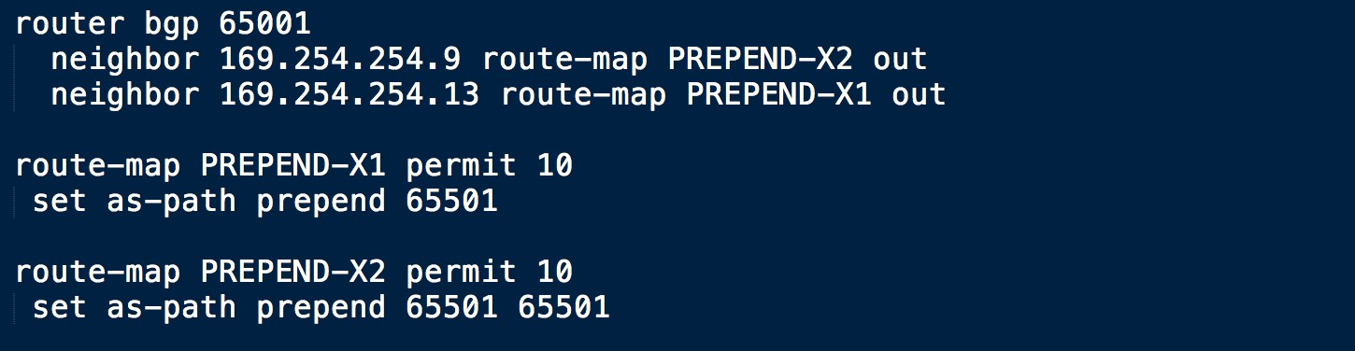
Dual VIF – Active/Passive
IP 169.254.254.9 /30
IP 169.254.254.13 /30

Slide 65
Active/Passive – the VGW Perspective
IP 169.254.254.10 /30
IP 169.254.254.14 /30

Slide 66
Public Virtual Interface
Provides access to Amazon Public IP Addresses
Requires Public IP Addresses for BGP Session
If you can’t provide them, raise a case with AWS Support
Public ASN must be owned by customer – Private is OK
Inter-Region is available in the US

Slide 67
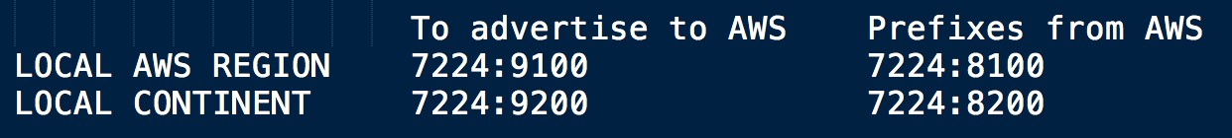
Public VIF – Inter-Region – US Only
Public VIF’s receive prefixes for all US Regions
Prefixes are identified by BGP Communities Advertisements can be controlled via BGP Communities

Slide 68

Public Virtual Interface
dxvif-wwxxyyzz
VLAN 200
IP 54.239.244.57 /31
BGP AS 7224
MD5 Key
Interface gi0/0.200
VLAN 200
IP 54.239.244.56 /31
BGP AS 65001
MD5 Key
172.16.0.0 /16
AS7224 Announcing 184.72.96.0/19 | via 7224 16509 14618 i
184.72.128.0/17 | via 7224 16509 14618 i
184.73.0.0 | via 7224 16509 14618 i
184.169.128.0/17 | via 7224 16509 i
199.127.232.0/22 | via 7224 16509 i
199.255.192.0/22 | via 7224 16509 I
…...
…..
AS65001 Announcing
54.239.244.56 /31
CORP

Slide 69
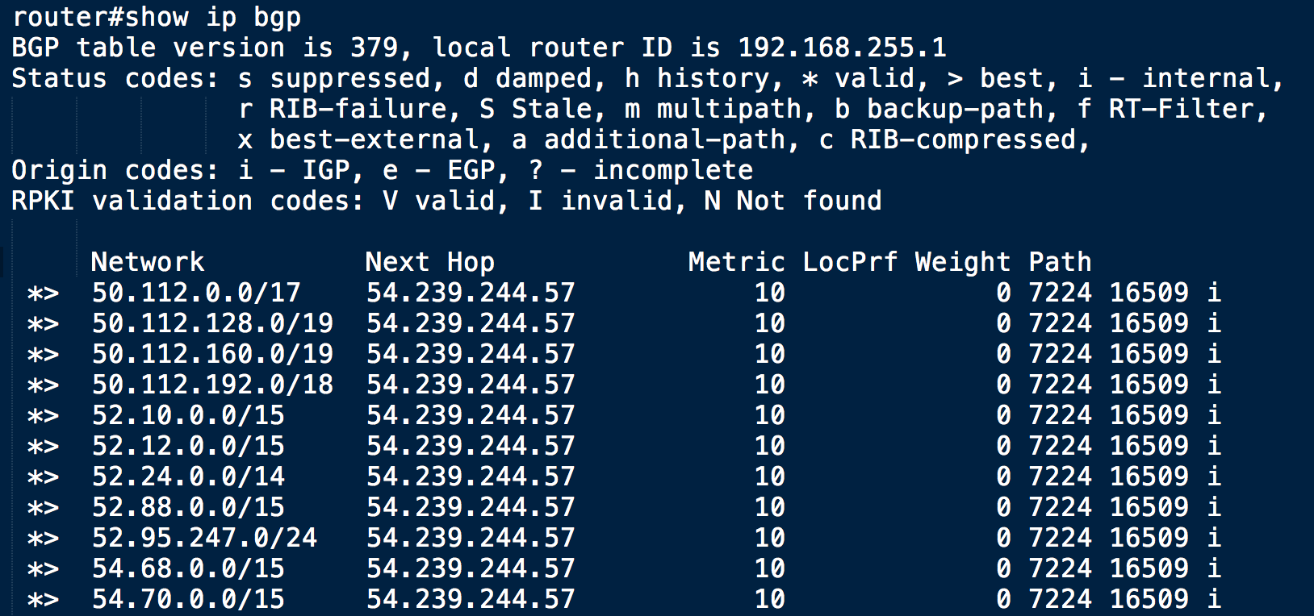
Public Virtual Interface
IP 54.239.244.57 /31
BGP AS 7224

Slide 70
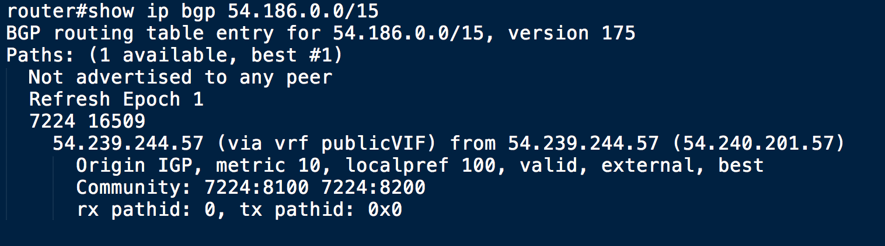
Public Virtual Interface
IP 54.239.244.57 /31
BGP AS 7224

Slide 71
Ordering Process

Slide 72
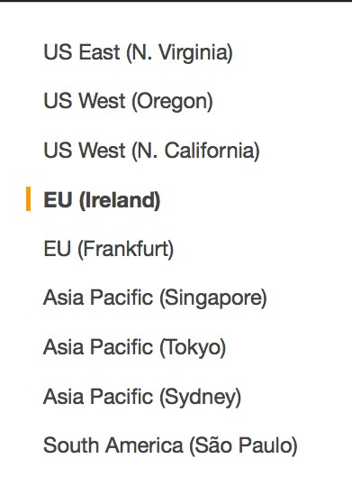
How to order AWS Direct Connect
Select Your Region
Create a Connection
Receive LOA-CFA
Cross Connect
Create Virtual Interface
6. Configure Customer Router

Slide 73
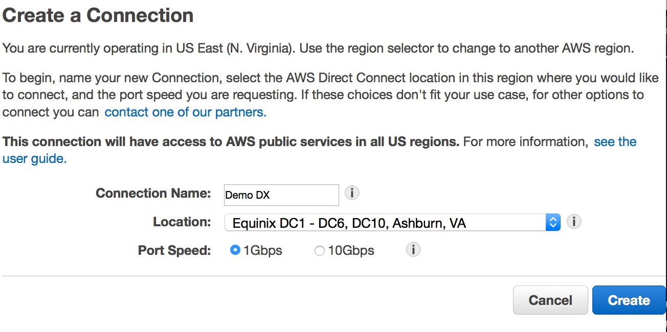
How to order AWS Direct Connect
Select Your Region
Create a Connection
Receive LOA-CFA
Cross Connect
Create Virtual Interface
6. Configure Customer Router

Slide 74
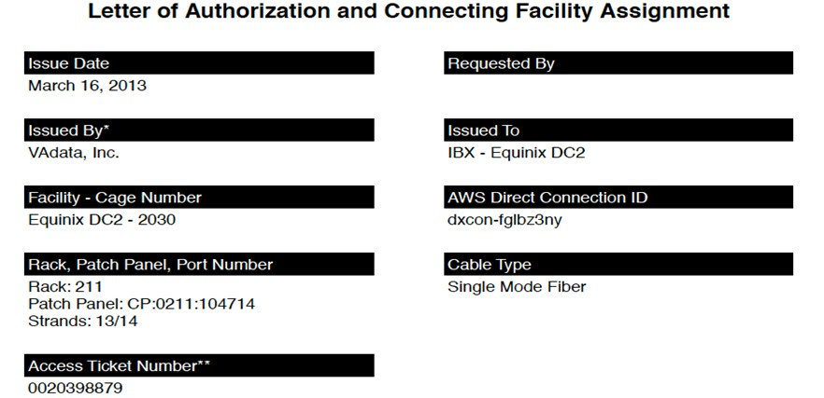
How to order AWS Direct Connect
Select Your Region
Create a Connection
Receive LOA-CFA
Cross Connect
Create Virtual Interface
6. Configure Customer Router

Slide 75
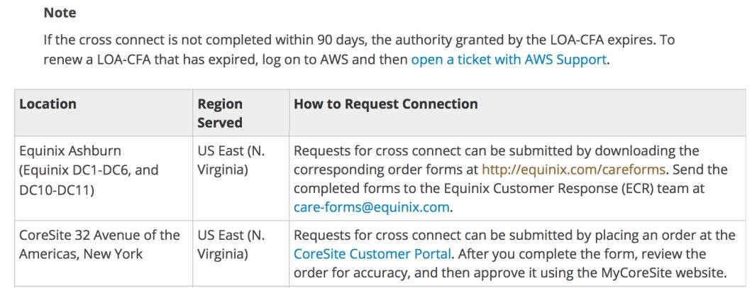
How to order AWS Direct Connect
Select Your Region
Create a Connection
Receive LOA-CFA
Cross Connect
Create Virtual Interface
6. Configure Customer Router

Slide 76
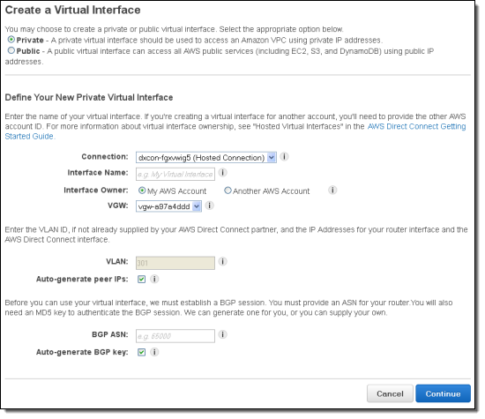
How to order AWS Direct Connect
Select Your Region
Create a Connection
Receive LOA-CFA
Cross Connect
Create Virtual Interface
6. Configure Customer Router

Slide 77
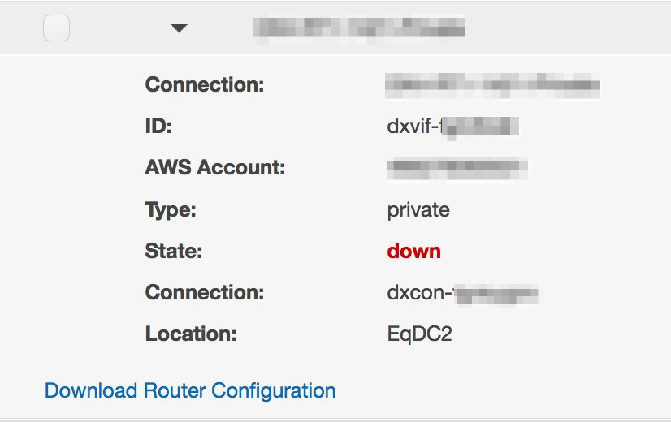
How to order AWS Direct Connect
Select Your Region
Create a Connection
Receive LOA-CFA
Cross Connect
Create Virtual Interface
6. Configure Customer Router

Slide 78
How to order sub-1G via an APN Partner
Provide your Direct Connect Partner with Account Number
Accept Hosted Connection
Create Virtual Interface
Configure Customer Router

Slide 79
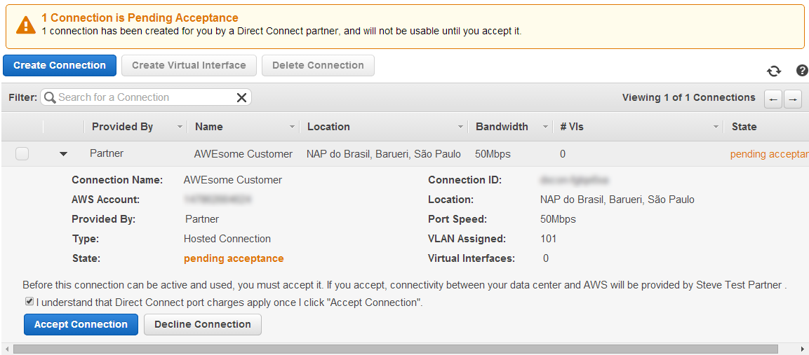
How to order sub-1G via an APN Partner
Provide your Direct Connect Partner with Account Number
Accept Hosted Connection
Create Virtual Interface
Configure Customer Router

Slide 80
How to order sub-1G via an APN Partner
Provide your Direct Connect Partner with Account Number
Accept Hosted Connection
Create Virtual Interface
Configure Customer Router

Slide 81
How to order sub-1G via an APN Partner
Provide your Direct Connect Partner with Account Number
Accept Hosted Connection
Create Virtual Interface
Configure Customer Router

Slide 82






Direct Connect with VPN Backup
DX Location 1
DX Location 2
CORP

Slide 83




Hardware VPN over DX Public VIF
dxvif-wwxxyyzz
VLAN 200
IP 54.239.244.57 /31
BGP AS 7224
MD5 Key
Interface gi0/0.200
VLAN 200
IP 54.239.244.56 /31
BGP AS 65001
MD5 Key
172.16.0.0 /16
Tunnel 1
Tunnel 1
IP 169.254.169.1 /30
IP 169.254.169.2 /30
BGP AS 17493
BGP AS 65001
Tunnel 2
Tunnel 2
IP 169.254.169.5 /30
IP 169.254.169.6 /30
BGP AS 17493
BGP AS 65001
CORP

Slide 84
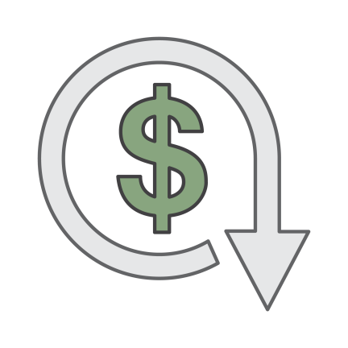
Billing
VPN Connections
Connection Hours
Data Transfer (Internet rates)
Direct Connect
Port Hours
Reduced Data Transfer Rates
No charge for resources owned by other accounts
VPN Data Transfer over Direct Connect at reduced rate

Slide 85
Things to remember
All Direct Connect locations are at 3rd party data centers You will have to work with at least one other organization
Could be just the Data Center
Could be a Network Provider / Direct Connect Partner
Could be multiple Network Providers AND the Data Center
Sub-1G Hosted Connections support a single VIF You can share VIF’s with other accounts
Public VIF’s include the Hardware VPN Endpoints

Slide 86
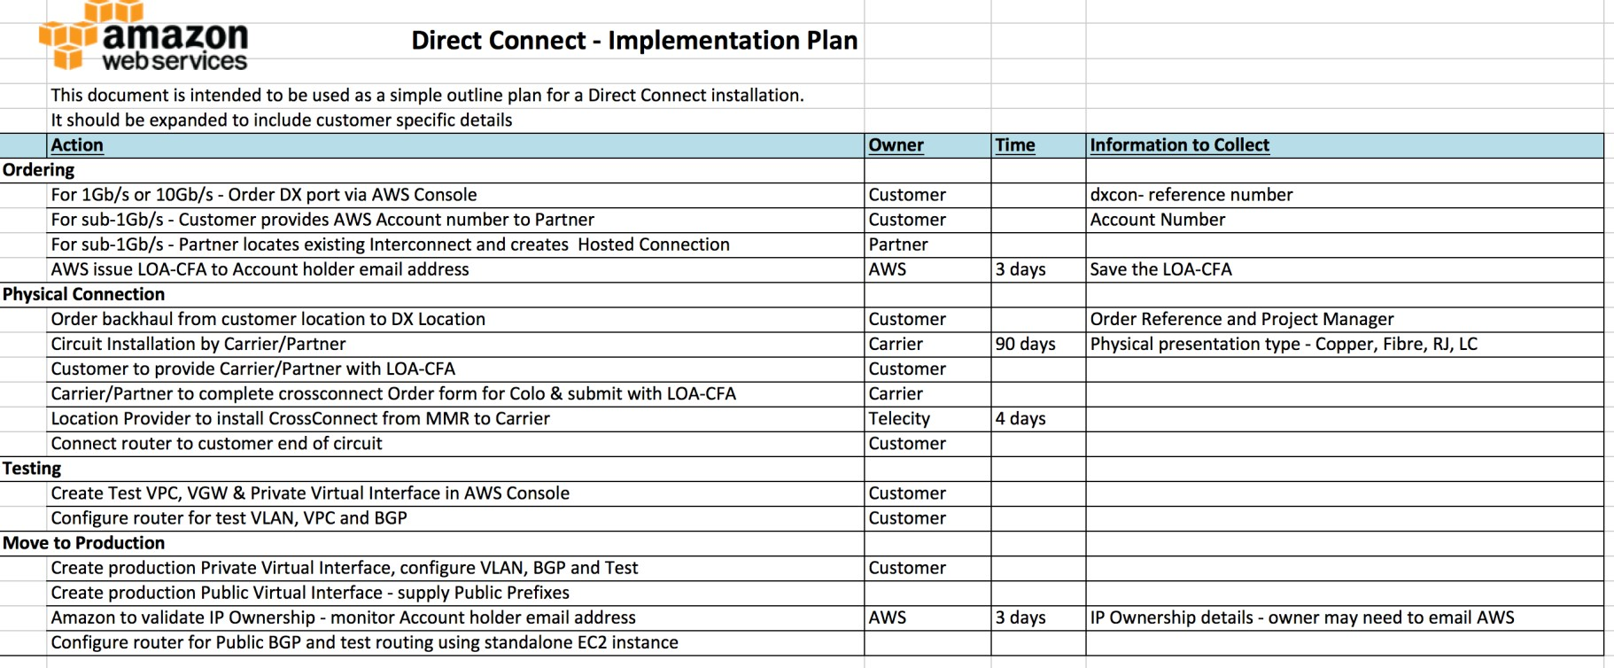
Example Implementation Plan

Slide 87




AWS CloudHub
AS65001
eBGP
AS65002
AS65003

Slide 88


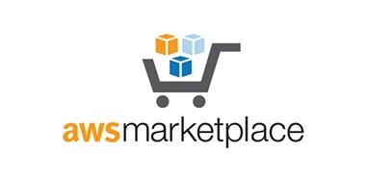
Software VPN
VPN

Slide 89
Software VPN
VPN
VPN

Slide 90



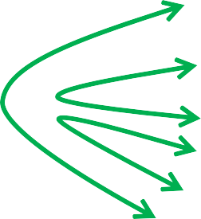
AWS CloudHub and Software VPN
EU-CENTRAL-1
US-EAST-1
VPN
VPN
AS65001
eBGP
AS65002
AS65003

Slide 91
Summary
Connectivity via VPN – Static & Dynamic
Connectivity via AWS Direct Connect – Public & Private CloudHub & Software VPN’s
Insight into the steps required

Slide 92
Thank you!

Slide 93
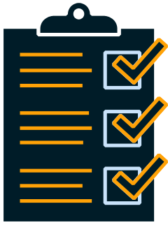
Remember to complete your evaluations!

Slide 94
Related Sessions
NET201 - Creating Your Virtual Data Center: VPC Fundamentals and Connectivity Options
NET301 - Next Gen Networking: New Capabilities for Amazon Virtual Private Cloud
NET307 - Pinterest: The Road From EC2-Classic to EC2-VPC
NET402 - Using Route53 to Consolidate DNS Infrastructure
NET403 - Another Day, Another Billion Packets with Amazon VPC
NET404 - Making Every Packet Count
NET409 - Movin’ On Up to Amazon VPC: How Twilio Migrated Its Services from EC2-Classic to EC2-VPC

